Slide 1
Multi-transit mapping
Citi Bike, MTA, Uber, Lyft, Zip Car, Car2Go

Slide 2
Requirements of transit map
Coordinates of Subway Entrances (to plant nodes)
Coordinates of Citi Bike Stations (to plant nodes)
Routing Paths of Lend Car Companies
Frequent Locations of Cars
Costs of all Transits
Zip Car and Car2Go location lists (must request by email)

Slide 3
Time vs. cost vs. exercise
 | Group A | Group B | Group C
Time Preference | 82 | 82 | 49
Cost Preference | 76 | 76 | 88
Exercise Preference | 34 | 84 | 90
Group A (students)
Group B (working adults)
Group C (elderly)

Slide 4
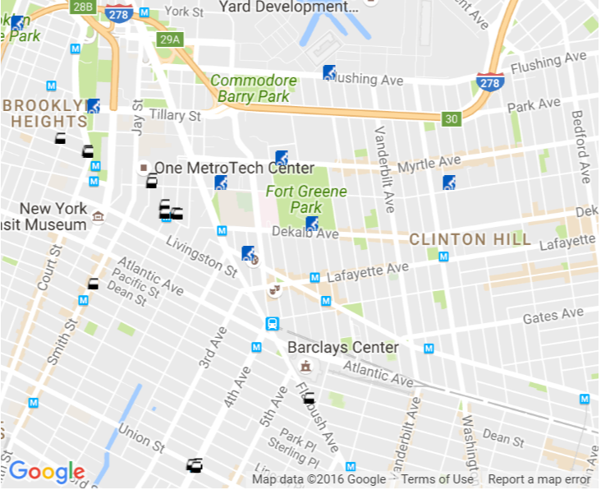
Algorithm considerations
First bullet point here
Second bullet point here
Third bullet point here
Group A
(student)
Changing subways between stations - free
Group B
(adult)
Citi bike costs for duration of time
Group C

Slide 5
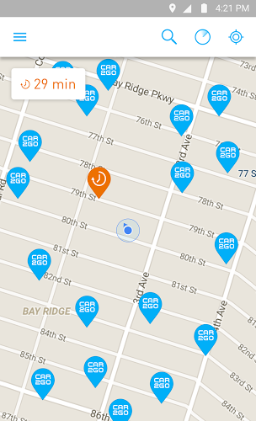
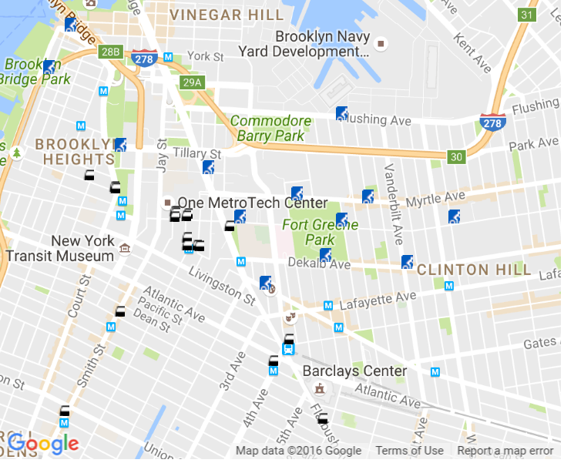
Plotting stations (left: car2go) (Right: mta + bikes)

Slide 6
Connect nodes in region
Enter location of destination
Select preference(s)
Calculate
Generate routes with no more than 3 intersections
Time
Walking / biking amount
Costs

